Slide 1

Vel Tech Rangarajan Dr. Sagunthala R&D Institute of Science and Technology
School of Computing
Department of Computer Science and Engineering
10211CS224 / FULL STACK APPLICATION DEVELOPMENT (JAVA)
PROJECT REVIEW : MILESTONE PROJECT – 1
Date:25-03-2026
End-to-End Event Lifecycle & Ticketing Platform
SDG: SDG 9 – Industry, Innovation and Infrastructure
Presented By:
CH.VENNELA REDDY– VTU25619– Reg.No.23UECS0956
Courses Handling Faculty:
Dr.S.Hemamalini

Slide 2
INTRODUCTION
1. Managing event tickets manually is difficult and time-consuming.
2. Users often struggle to find all events in one place.
3. Booking systems without seat selection are not user-friendly.
4. This project provides a single platform for event discovery and booking.
5. It allows users to select seats and book tickets easily.
6. Organizers can manage events and track bookings efficiently.
7. The system is useful in real-world applications like concerts, fests, and shows.
8. Overall, it simplifies the complete event ticketing process for users and organizers.
1
2
3
4
5
6
7
8
9

Slide 3
PROBLEM STATEMENT
Existing event ticketing systems are spread across multiple platforms, making it difficult for users to find and book tickets easily. Users also face problems in booking multiple tickets and managing them in one place. This leads to confusion and inefficiency. Therefore, there is a need for a simple and centralized system where users can view events from different platforms and book multiple tickets easily.
1
2
3
4
5
6
7
8
9

Slide 4
OBJECTIVE(S)
1. To design and develop a centralized event ticketing system that allows users to view and book tickets from multiple platforms.
2. To implement a feature that enables users to book and manage multiple tickets easily within a single system.
3. To improve user experience by providing a simple and efficient interface for event discovery and booking.
4. To develop a reliable system for managing events, bookings, and user data effectively.
1
2
3
4
5
6
7
8
9

Slide 5
PROPOSED SYSTEM
1. The proposed system is a centralized event ticketing platform that displays events from multiple sources in one place.
2. It allows users to view event details, select seats, and book multiple tickets easily.
3. The system stores all bookings in a single database for easy access and management.
4. It solves the problem of switching between different platforms by providing all events in one interface.
5. Users can manage their tickets and bookings efficiently within the system.
6. Organizers can track ticket availability and bookings in real time.
7. The system reduces manual effort and improves accuracy in ticket management.
8. Compared to existing systems, it offers better convenience, centralized access, and improved user experience.
1
2
3
4
5
6
7
8
9

Slide 6
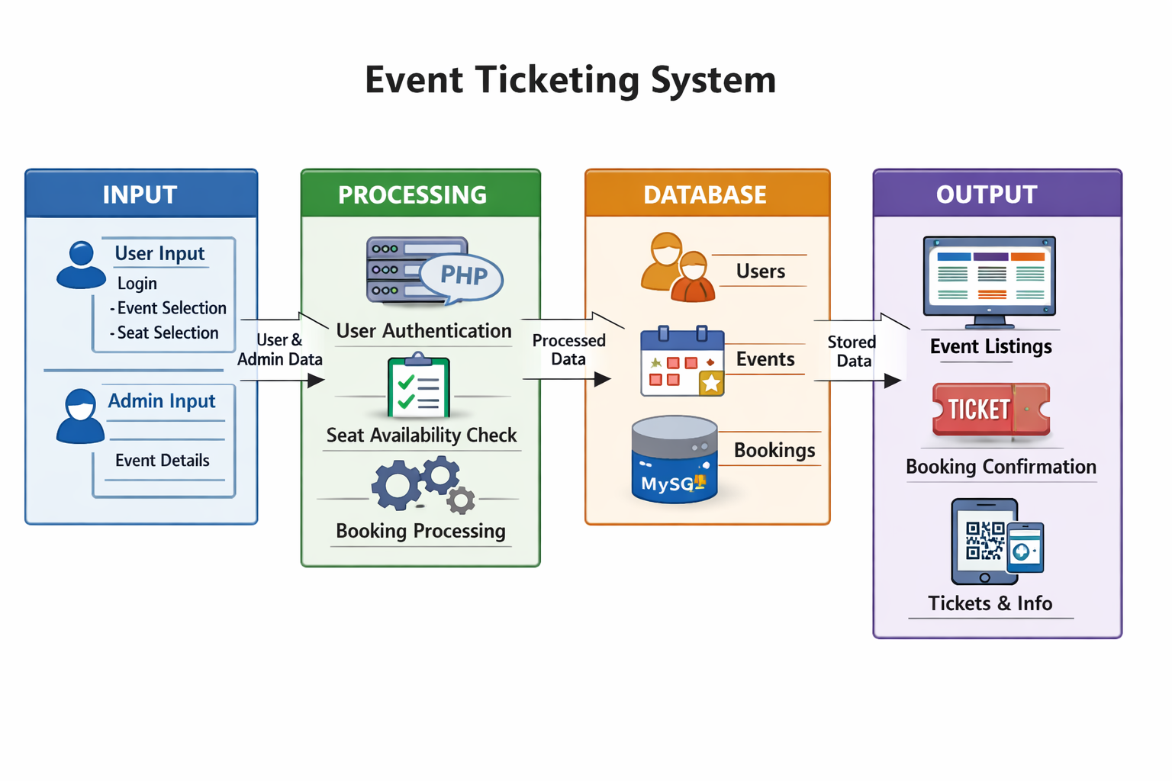
PROPOSED SYSTEM ARCHITECTURE
1
2
3
4
5
6
7
8
9

Slide 7
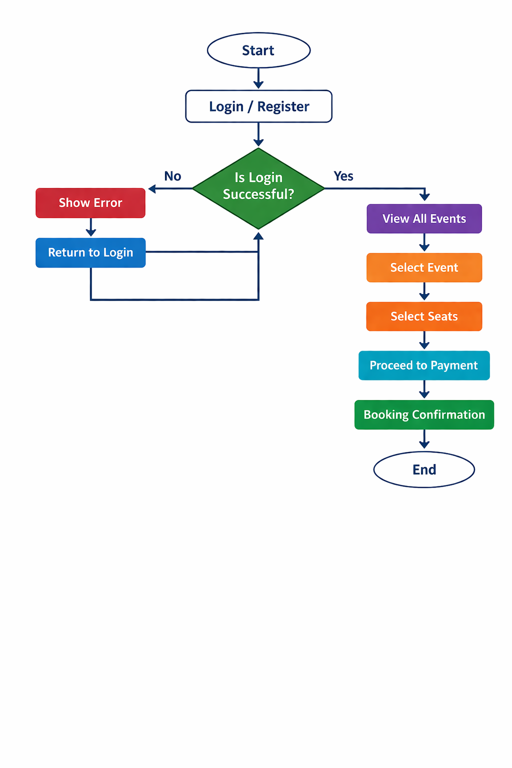
WORKFLOW
1
2
3
4
5
6
7
8
9

Slide 8
TECHNOLOGIES USED
Frontend: HTML5, CSS3, JavaScript (ES6)
Backend: PHP
Database: MySQL
Tools: XAMPP, VS Code, phpMyAdmin
Hardware/Software Requirements: A laptop with minimum 4GB RAM, web browser (Chrome/Edge), XAMPP server installed
1
2
3
4
5
6
7
8
9

Slide 9
MODULE DESCRIPTION
1. User Module – This module handles user registration, login, and logout functionalities. It ensures only authenticated users can access the system.
2. Event Module – This module displays all available events with details like date, location, and price. It helps users browse and select events easily.
3. Booking Module – This module allows users to select seats and book tickets for events. It processes booking details and stores them in the database.
4. My Tickets Module – This module enables users to view their booked tickets and booking history. It helps users manage and track their bookings.
1
2
3
4
5
6
7
8
9

Slide 10
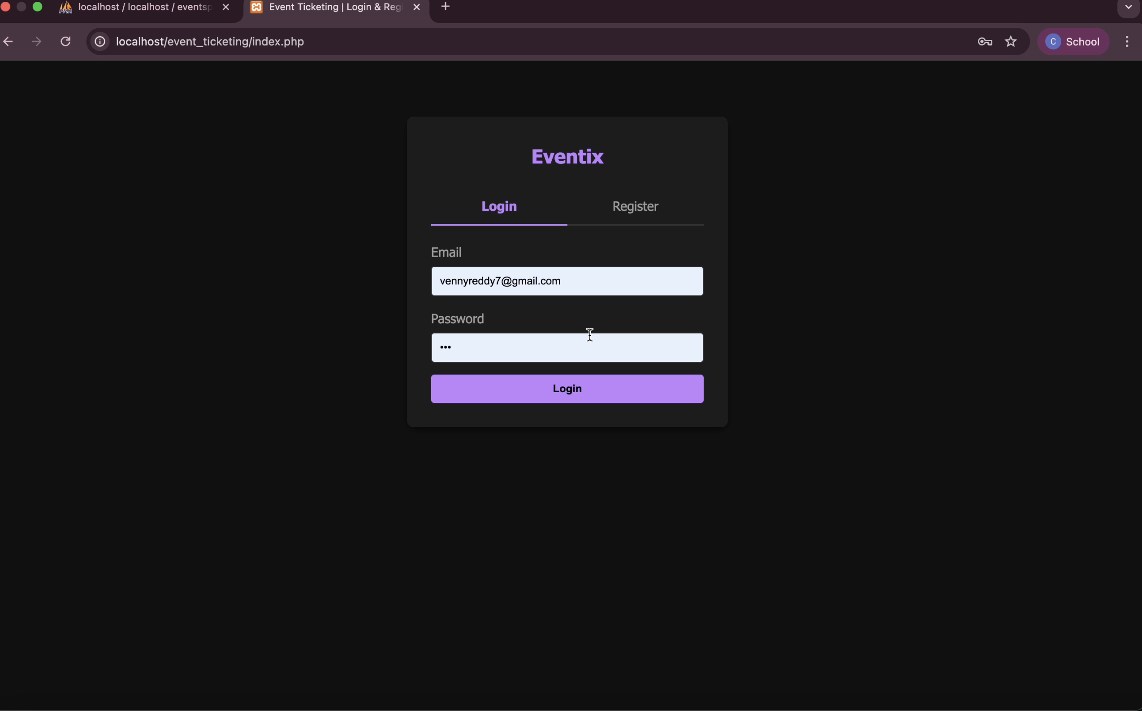
IMPLEMENTATION SCREENSHOTS
1
2
3
4
5
6
7
8
9

Slide 11
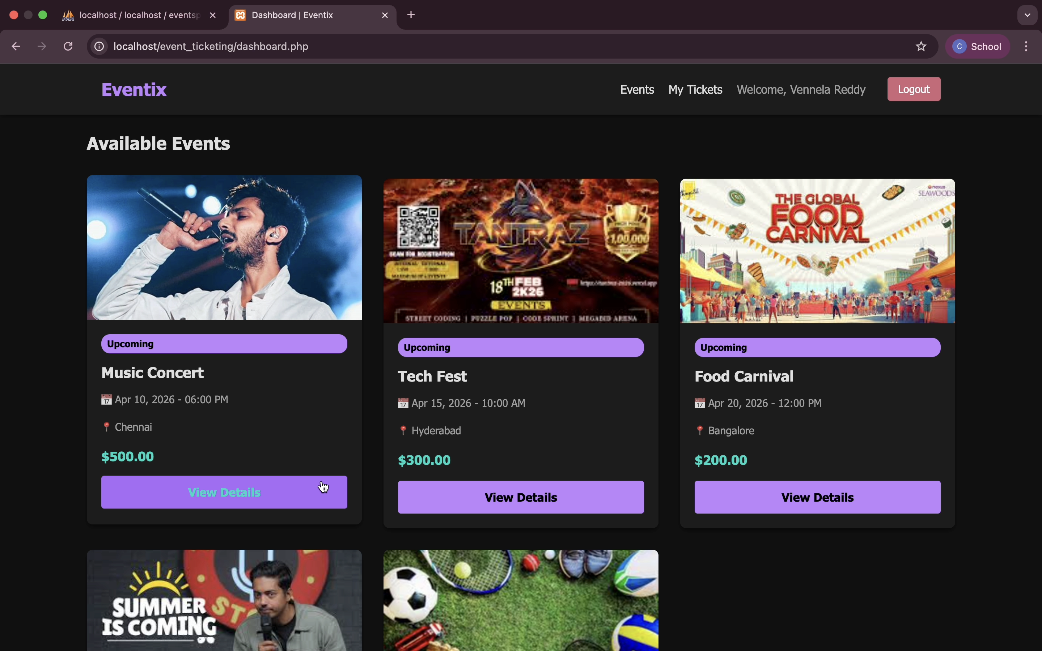
IMPLEMENTATION SCREENSHOTS
1
2
3
4
5
6
7
8(A)
9

Slide 12
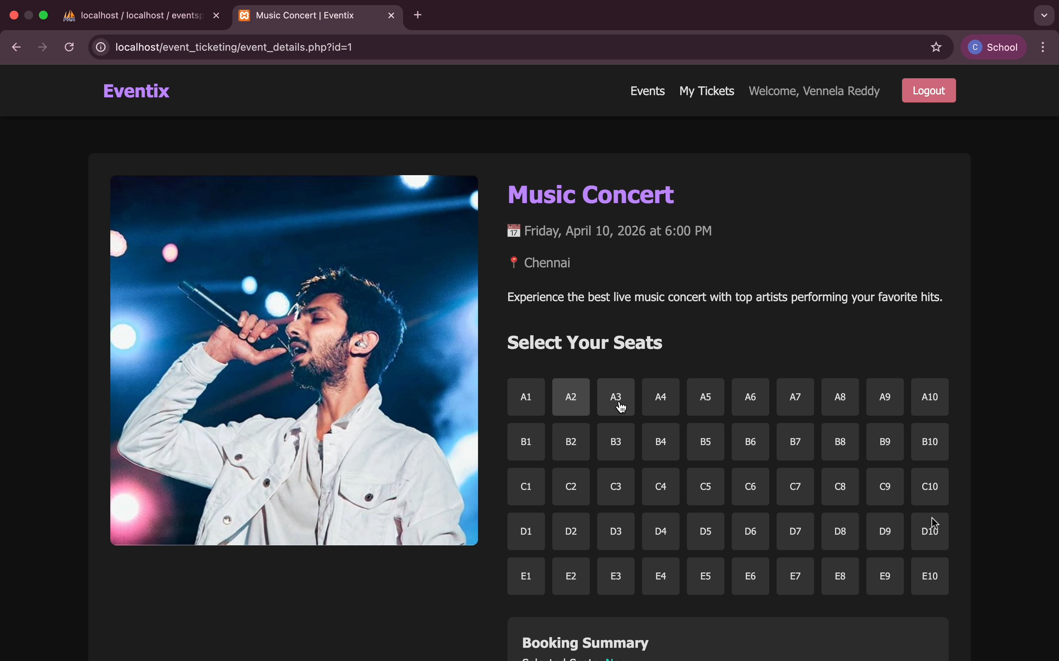
IMPLEMENTATION SCREENSHOTS
1
2
3
4
5
6
7
8(B)
9

Slide 13
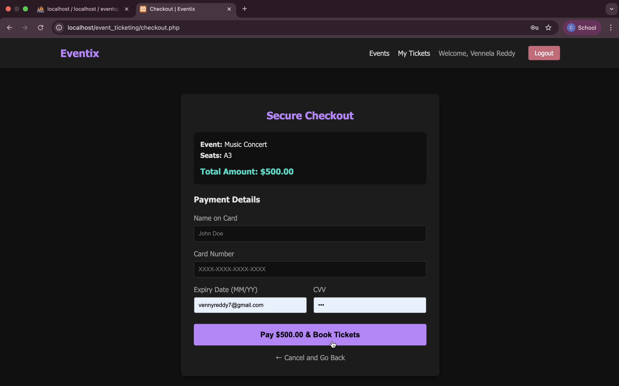
IMPLEMENTATION SCREENSHOTS
1
2
3
4
5
6
7
8(C)
9

Slide 14
ADVANTAGES & LIMITATIONS
1
ADVANTAGES:
Provides a centralized platform to view events from multiple sources
Easy and user-friendly interface
Allows users to select seats and book multiple tickets
Reduces manual effort and saves time
Stores all booking details in one place for easy access
2
3
4
5
DISADVANTAGES:
1.Needs Internet connection
2.Not integrated to perform in Real Time
6
7
8
9

Slide 15
Thank you

